Slide 1
CIS 5930 Productivity in Software Engineering Project Phase 2
“Technical Debt Cripples Software Developer Productivity”
Jordan Gethers, Sineha Aneel, Aditi Allady

Slide 2
Tasks completed
Created question bank
Created questionnaire
Sent out the questionnaire
Sent reminders for questionnaire
Received expected number of responses for questionnaire
Initial analysis of responses

Slide 3
Tasks to be completed
Thorough analysis of the responses
Compare and contrast with our hypothesis
Compare results with the chosen paper
Create visualizations
Finalize and document results

Slide 4
Questionnaire
https://forms.gle/LySbh5d9jqouyE2U6

Slide 5
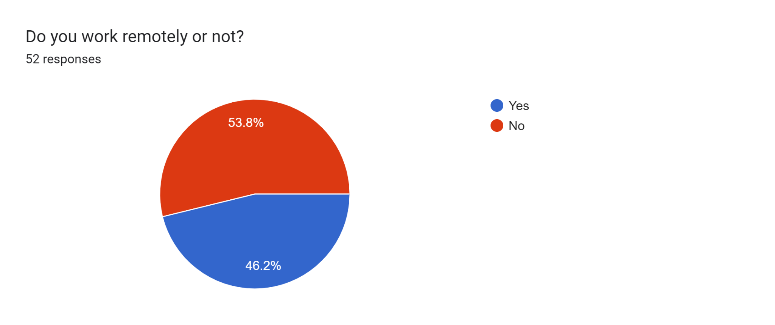
Questions of interest
Do you work remotely?
Notes:
Remote work seems to be typical instead of a small minority

Slide 6
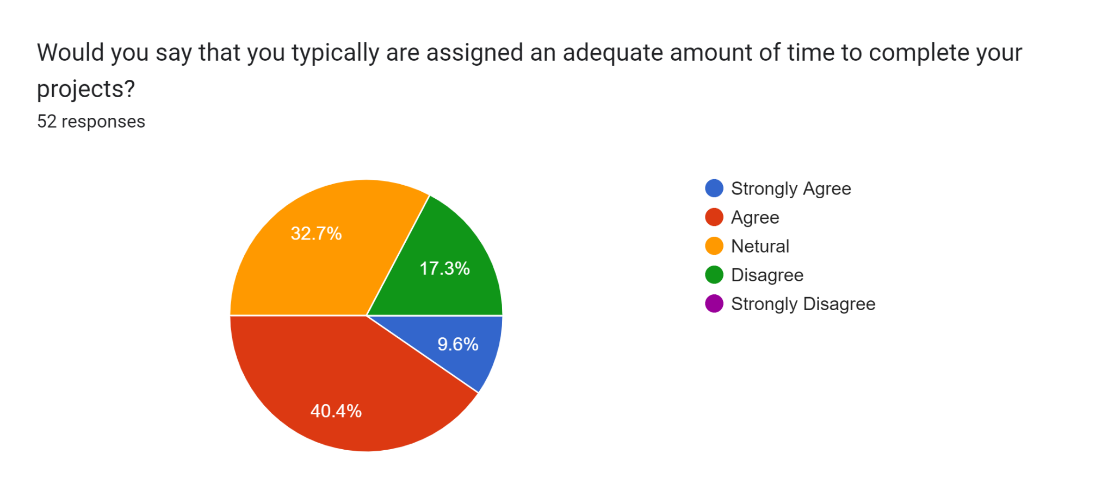
Questions of interest
Would you say that you typically are assigned an adequate amount of time to complete your projects?

Slide 7
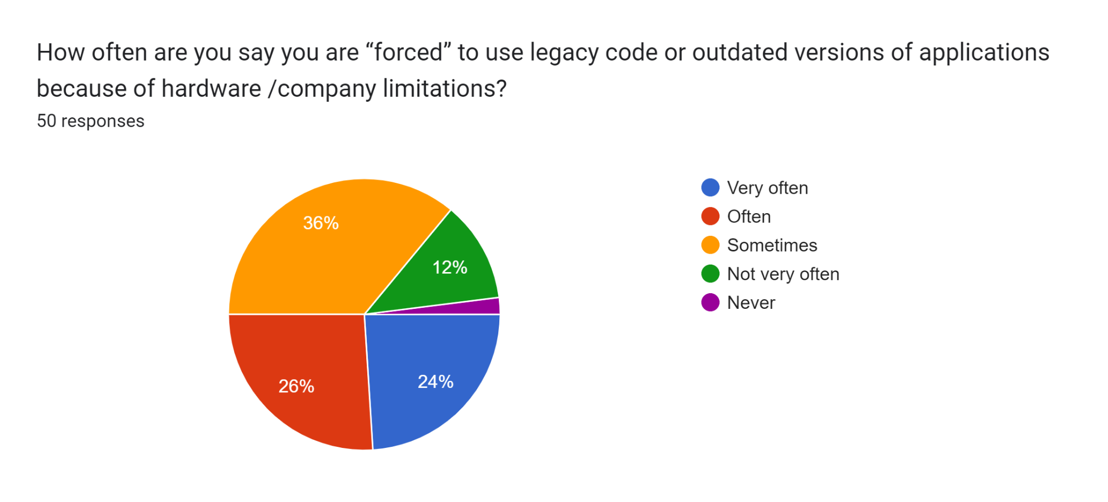
Legacy/Outdated Code
How often are you say you are “forced” to use legacy code or outdated versions of applications because of hardware /company limitations?
Notes:
Although we are continuously building new technologies, it seems as though the industry is always quite a bit behind current best practices and standards.

Slide 8
Contributions
Aditi Allady
Created the Github
Created the Technical Debt Questionnaire Form
Wrote some of the Technical Debt Questions
Wrote some of the project proposal
Asked people to answer a questionnaire in the class, and other people in other classes and also who work in the cs department to answer the questionnaire(got 17 people to answer)
Sent a reminder to the participants who have not filled out the form yet

Slide 9
Contributions
Sineha Aneel
Asked people to answer a questionnaire in the class, and other people in other classes and also who work in the cs department to answer the questionnaire(got 17 people to answer)
Wrote some of the project proposal
Wrote some of the Technical Debt Questions
Sent a reminder to the participants who have not filled out the form yet

Slide 10
Contributions
Jordan Gethers
Asked people to answer a questionnaire in the class, and other people in other classes and also who work in the cs department to answer the questionnaire(got 17 people to answer)
Wrote some of the project proposal
Wrote some of the Technical Debt Questions
Sent a reminder to the participants who have not filled out the form yet

